Slide 1
ELE 442 – Control Systems
Topic 1: Introduction

Slide 2
What is Control?
Make a system (known as process or plant) behave as we desire
Almost all systems involve one form of control
  Airconditioning systems (room temperature control)
  Cars/drones (trajectory/speed control)
  Computer Numerical Control Machines (position control)
  Human body (body temperature/blood pressure…control)

Slide 3
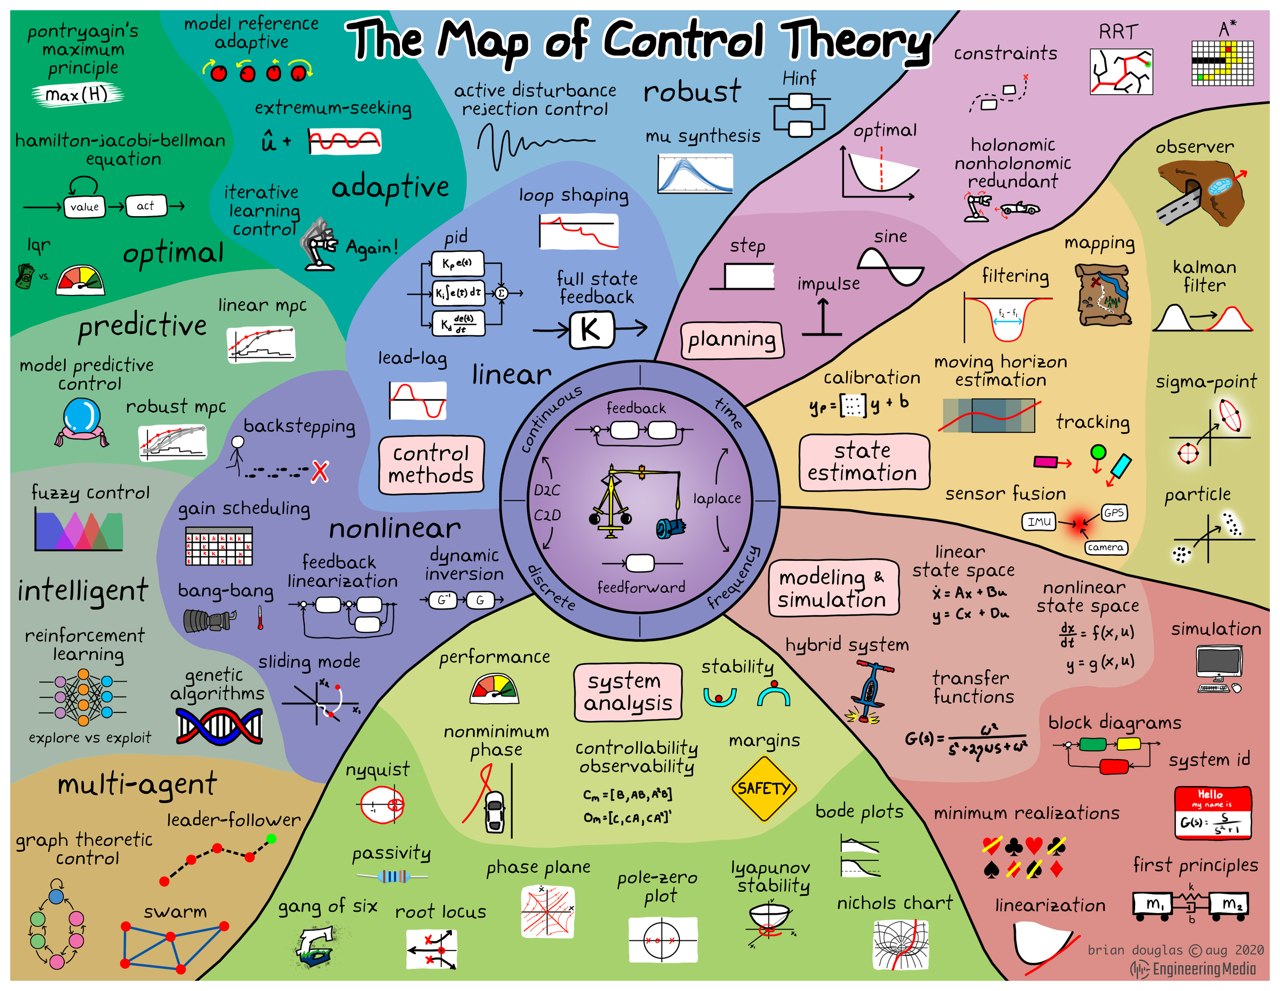
What is Control Theory?

Slide 4
Why are Control Systems needed?
Convenience (everyday appliances)
Dangerous tasks (space exploration, mine field clearance)
Impossible for humans (nanometer scale precision positioning)
Industrial scale tasks (car-painting, production line efficiency)

Slide 5
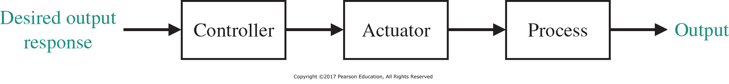
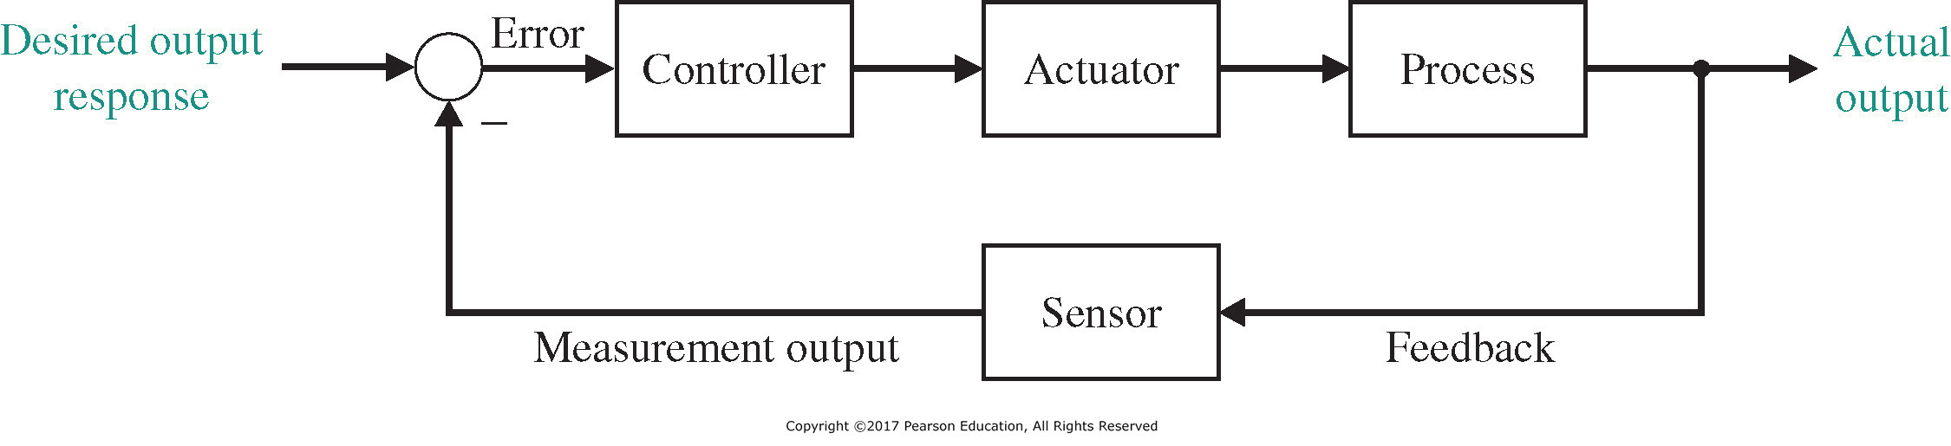
Types of Control
Open-Loop Control
Closed-Loop Control

Slide 6
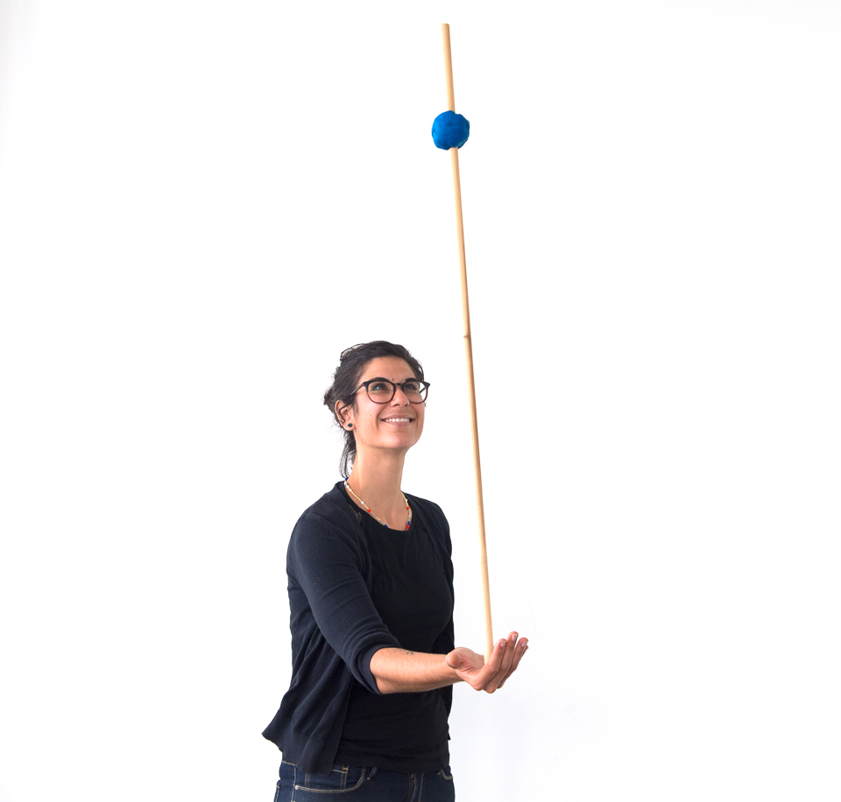
Open-Loop Control
Actuator is controlled without feedback
No feedback means no sensors
Sensitive to disturbances
Needs calibration
https://www.exploratorium.edu/

Slide 7
Open-Loop Control - Examples
Laundry Machine
No measurement of the clothes’ cleanliness
Control based on predetermined settings
Laundry Machine
(Plant/Process)
Washing Program
Washed Clothes

Slide 8
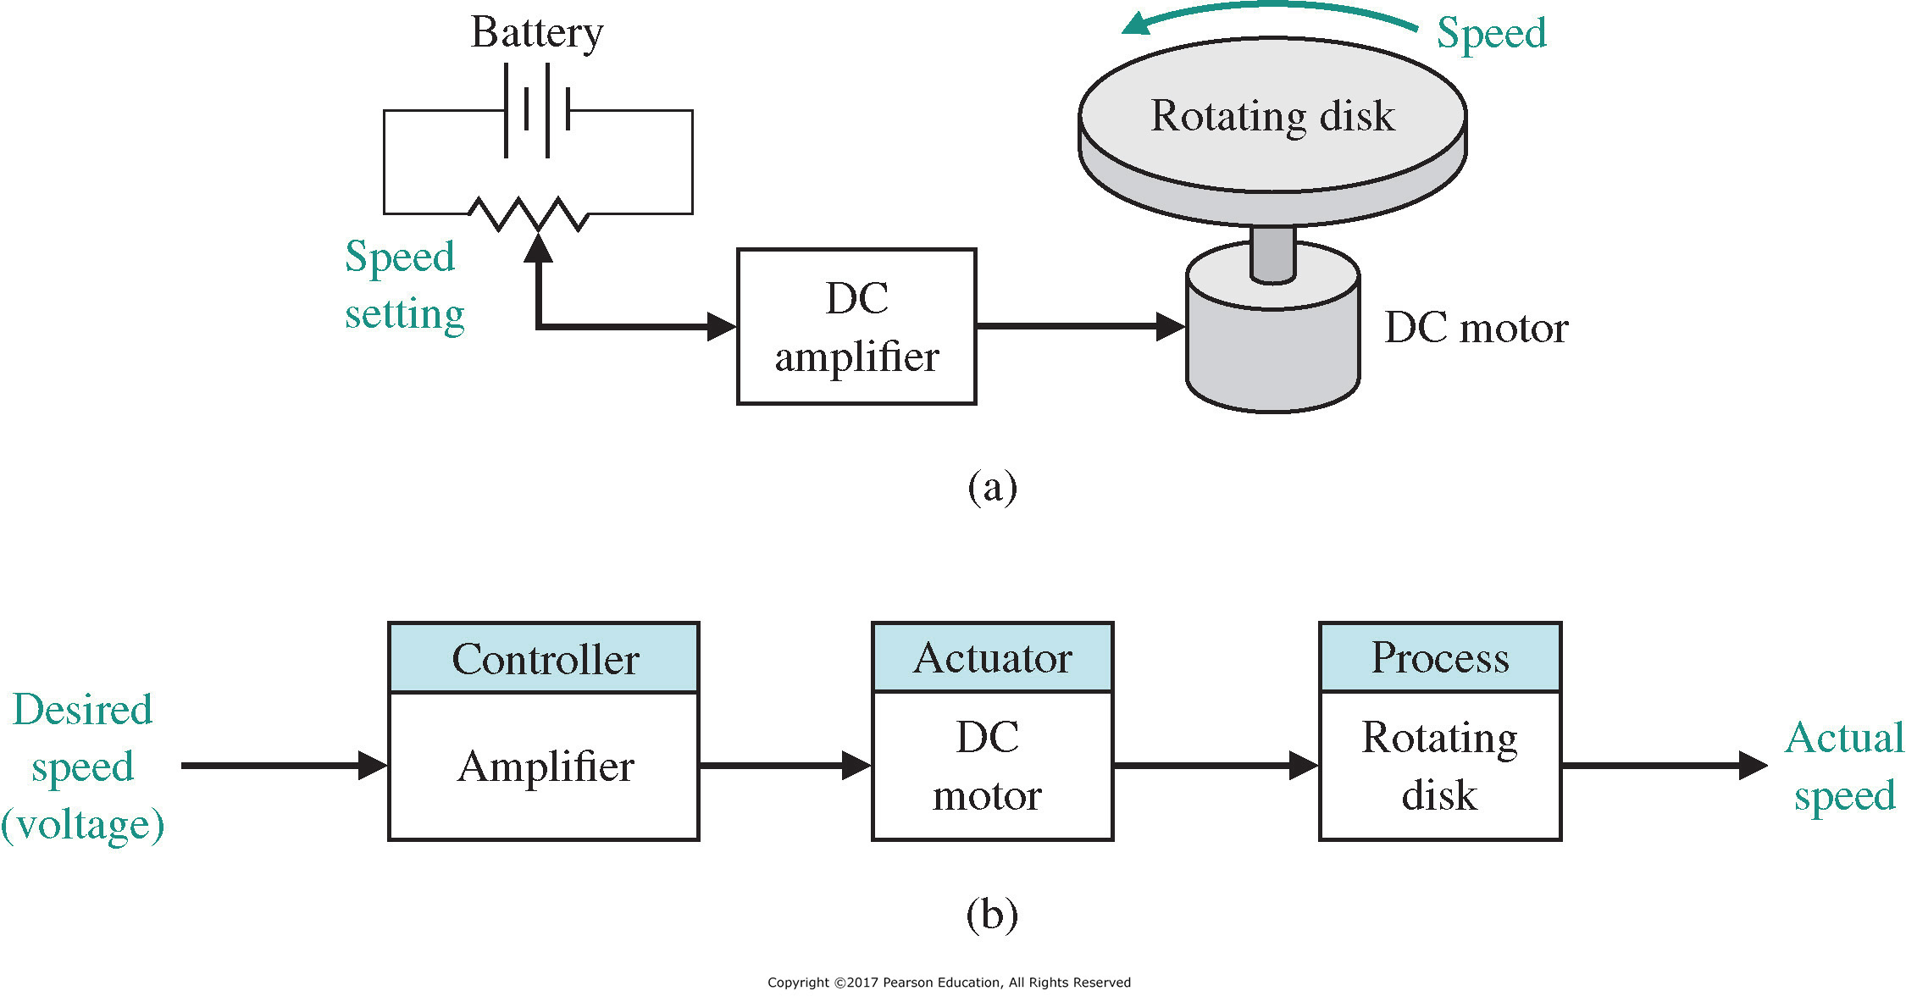
Open-Loop Control - Examples
Open-Loop speed control of DC Motor

Slide 9
Closed-Loop Control
Controller acts based on the error between
desired output & actual output
Actual output is obtained through sensors
https://www.exploratorium.edu/

Slide 10
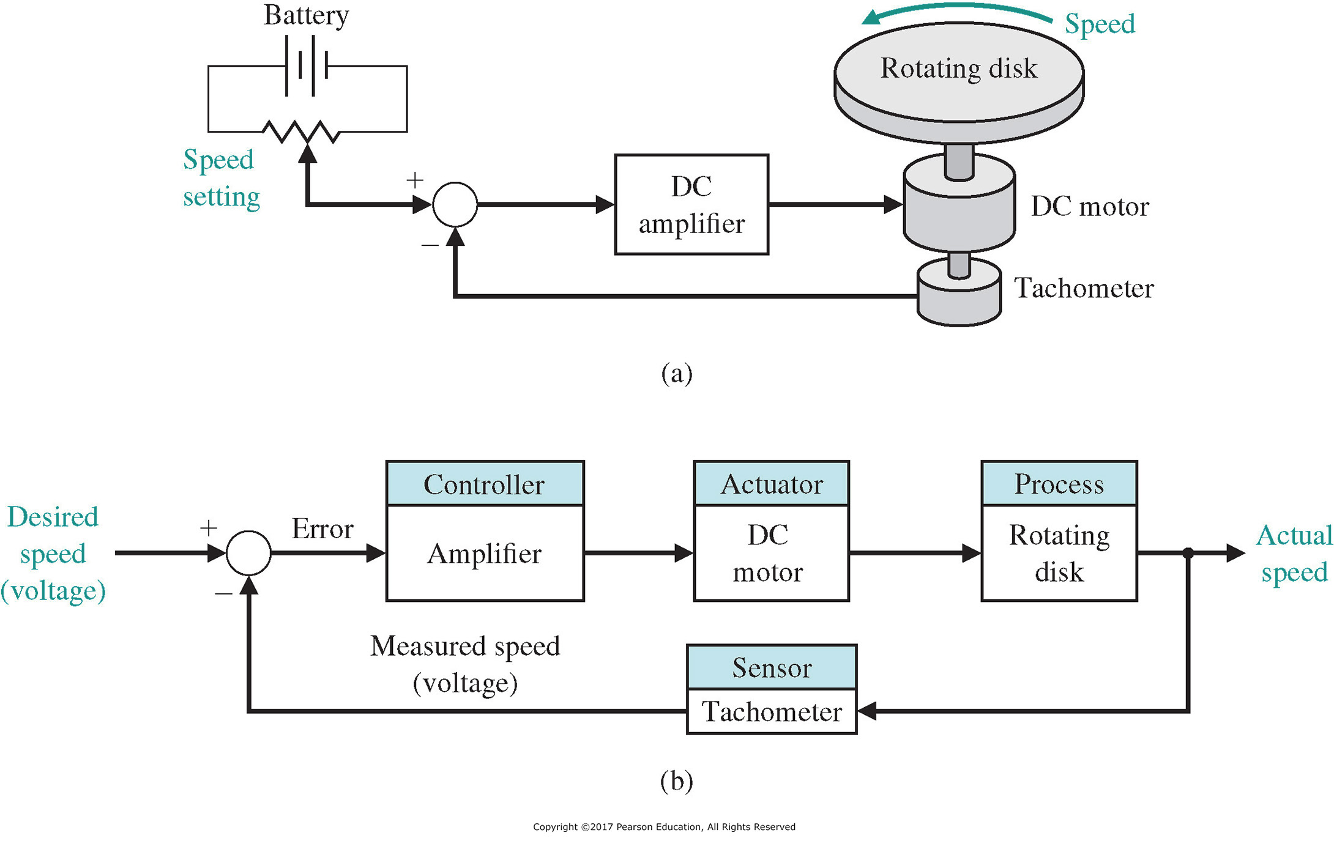
Closed-Loop Control - Examples
Closed-Loop speed control of DC Motor
feedback

Slide 11
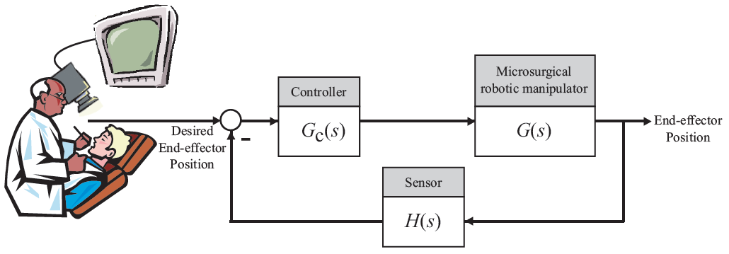
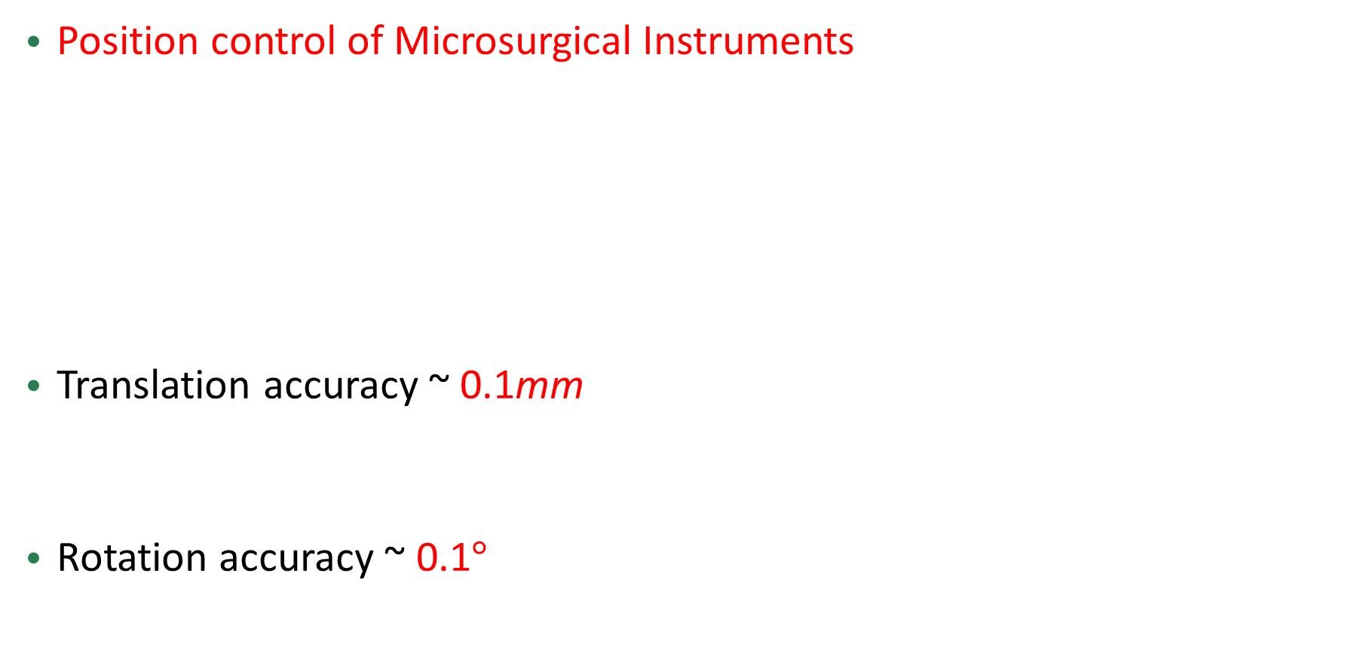
Closed-Loop Control - Examples
Position control of Microsurgical Instruments
Translation accuracy ~ 0.1mm
Rotation accuracy ~ 0.1$°$

Slide 12
Controller Design Process
4. Implementation
1. Modeling
Controller
Mathematical Model
2. Analysis
3. Design

Slide 13
Controller Design Process
Modeling (Transfer Function & Block Diagram)
  Laplace Transform
  Mechanical, electrical, electromechanical systems
Analysis
  Step Response, frequency response, ramp response
  Stability: Routh-Hurwitz criterion
Design
  Root locus, frequency response
  PID control, lead/lag compensator

